Slide 1

OOTO Information Miner
A2j : If this statement is false, it cannot be true there for it is true and since it is true it is false and since it is false it is true and since it is true it is false… | 25% | 75% | 0% | 11% | 89% | 0%
A2j : If this statement is false, it cannot be true there for it is true and since it is true it is false and since it is false it is true and since it is true it is false… | 25% | 75% | 0% | 11% | 89% | 0%
A2j : If this statement is false, it cannot be true there for it is true and since it is true it is false and since it is false it is true and since it is true it is false… | 25% | 75% | 0% | 11% | 89% | 0%
A2j : If this statement is false, it cannot be true there for it is true and since it is true it is false and since it is false it is true and since it is true it is false… | 25% | 75% | 0% | 11% | 89% | 0%
A2j : If this statement is false, it cannot be true there for it is true and since it is true it is false and since it is false it is true and since it is true it is false… | 25% | 75% | 0% | 11% | 89% | 0%
A2j : If this statement is false, it cannot be true there for it is true and since it is true it is false and since it is false it is true and since it is true it is false… | 25% | 75% | 0% | 11% | 89% | 0%
99% Confidence interval χ2
PHILIPPINES
Notes:
Simple Questions
It’s a table

Slide 2
Male vs Female

Slide 3
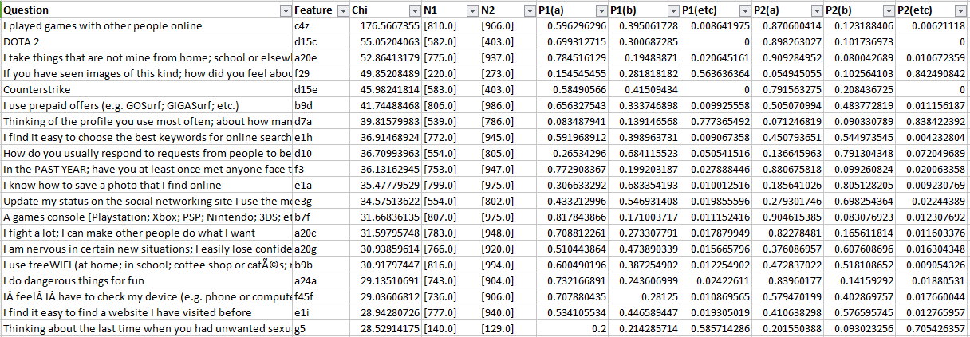

Slide 4
OOTO Information Miner
99% Confidence interval χ2
PHILIPPINES
 | Male |  |  | Female
 | a | b | etc | a | b | etc
A14: How often do you get some new clothes to wear? | 11% | 86% | 3% | 6% | 91% | 3%
A18: Do you have at least two pairs of properly fitting shoes? [include: boots; sandals; trainers; etc.] | 19% | 79% | 2% | 11% | 88% | 0%
A19: How often do you get some new games or toys to play with? | 51% | 44% | 5% | 55% | 37% | 8%
Note:
a = Hardly ever/No
b = Once or twice a year/Every few months/Every few weeks/Yes
etc = Prefer not to say
Notes:
Simple Questions
It’s a table

Slide 5
OOTO Information Miner
99% Confidence interval χ2
PHILIPPINES
A20: Please tell me how true are the following things for you? | Male |  |  | Female
 | a | b | etc | a | b | etc
A20a: I get very angry and often lose my temper | 41% | 58% | 1% | 31% | 68% | 1%
A20c: I fight a lot; I can make other people do what I want | 71% | 27% | 2% | 82% | 17% | 1%
A20d: I am often accused of lying or cheating | 67% | 32% | 1% | 74% | 24% | 2%
A20e: I take things that are not mine from home; school or elsewhere | 78% | 19% | 2% | 91% | 8% | 1%
A20f: I worry a lot | 33% | 66% | 2% | 24% | 75% | 1%
Note:
a = Not true for me
b = A bit/Fairly/Very true forme
etc = Prefer not to say
Notes:
Simple Questions
It’s a table

Slide 6
OOTO Information Miner
99% Confidence interval χ2
PHILIPPINES
A20: Please tell me how true are the following things for you? | Male |  |  | Female
 | a | b | etc | a | b | etc
A20g: I am nervous in certain new situations; I easily lose confidence | 51% | 47% | 2% | 38% | 61% | 2%
A20i: I am often unhappy; sad or tearful | 52% | 47% | 1% | 44% | 55% | 1%
A20j: I have many fears and I am easily scared | 41% | 58% | 2% | 31% | 67% | 1%
A20l: I finish the work I'm doing. My attention is good | 0.247368421 | 0.736842105 | 0.015789474 | 0.180540541 | 0.804324324 | 0.015135135
A20u: I am helpful if someone is hurt; upset or feeling ill | 0.254666667 | 0.725333333 | 0.02 | 0.170418006 | 0.814576635 | 0.015005359
A20v: I try to be nice to other people. I care about their feelings | 0.210666667 | 0.774666667 | 0.014666667 | 0.146262189 | 0.843986999 | 0.009750813
A20w: I often volunteer to help others (e.g.; parents; carers; teachers; children) | 0.22386059 | 0.750670241 | 0.025469169 | 0.169197397 | 0.818872017 | 0.011930586
A20x: I usually share with others (food; games; pens etc.) | 0.169333333 | 0.816 | 0.014666667 | 0.117583603 | 0.872707659 | 0.009708738
Notes:
Simple Questions
It’s a table

Slide 7
OOTO Information Miner
PHILIPPINES
CONTEXT
Notes:
Single Question

Slide 8
OOTO Information Miner
PHILIPPINES
Mining Experiments
Dataset 1 | # | Dataset 2 | # | #Significant Variables
Male | 872 | Female | 772 | 127
Age Group: 9-11 | 586 | Age Group: 12-14 | 656 | 134
Age Group: 12-14 | 656 | Age Group: 15-17 | 640 | 109
Age Group: 9-12 | 586 | Age Group: 15-17 | 640 | 212
Nation | 1882 | Sultan Kudarat | 74 | 14
(A20i) : Happy | 814 | (A20i): Sad | 877 | 262
(A17a) : Rarely eat meat or fish | 205 | (A17a) : Frequently eat meat or fish | 1492 | 85
Notes:
Mining Experiments
It’s a table

Slide 9
OOTO Information Miner
PHILIPPINES
Mining Experiments
Dataset 1 | # | Dataset 2 | # | #Significant Variables
Sultan Kudarat | 74 | Cavite | 96 | 5
Batangas | 87 | Cavite | 96 | 10
Sultan Kudarat | 74 | Batangas | 87 | 7
Nation | 1882 | Cavite | 96 | 50
Notes:
Mining Experiments
It’s a table

Slide 10
OOTO Information Miner
PHILIPPINES
Male vs Female
Notes:
Multiple Questions

Slide 11
OOTO Information Miner
PHILIPPINES
Male vs Female
Notes:
Mining Experiments
It’s a table

